Slide 1
A quick guide for data extraction from the
FieldSpec-Laptop with
View Spec Pro
For further processing with R
and data annotation in MS Excel

Slide 2
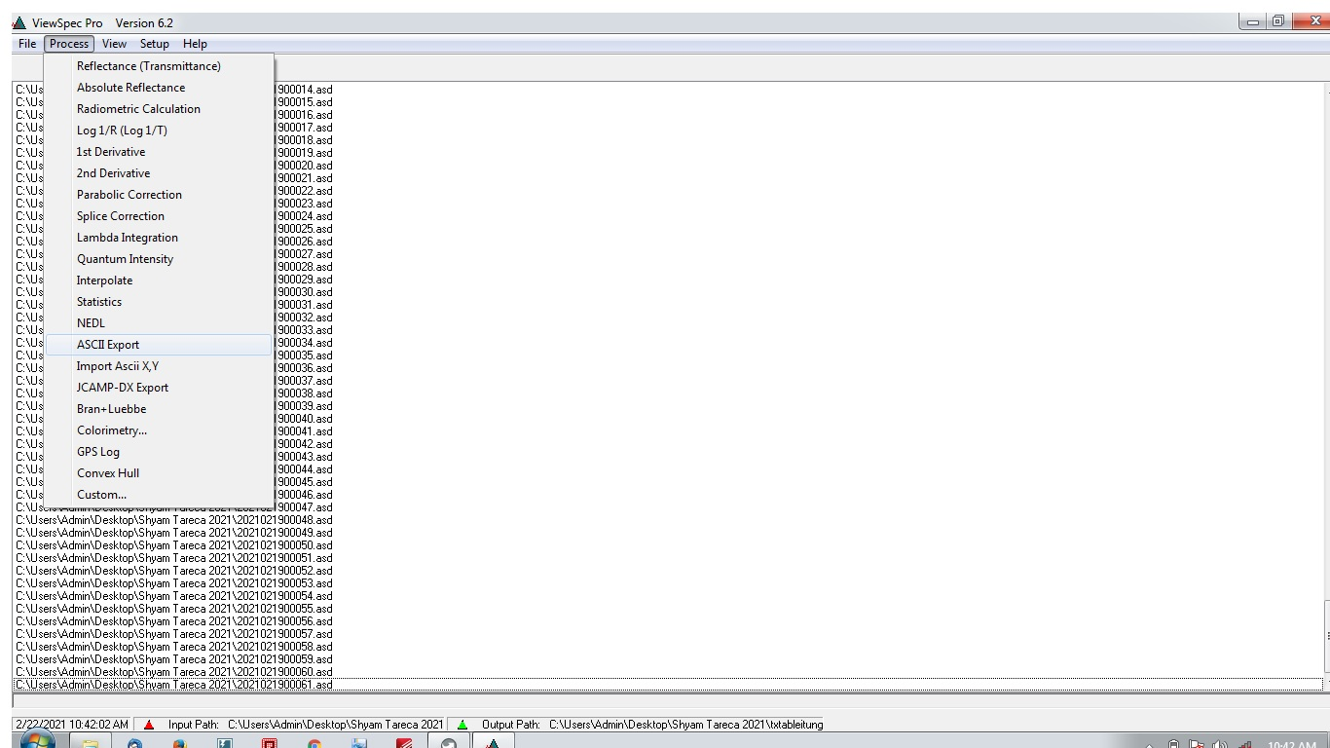
Set output path [File → …] Note: Should differ from .asd files folder
Check output path
Load .asd files in VieSpec Pro [File → Open]
Export data as .txt to the selected output folder [Process → ASCII Export] (screenshot) Note: All files in the ViewSpec environment must be selected [ctrl + a]

Slide 3
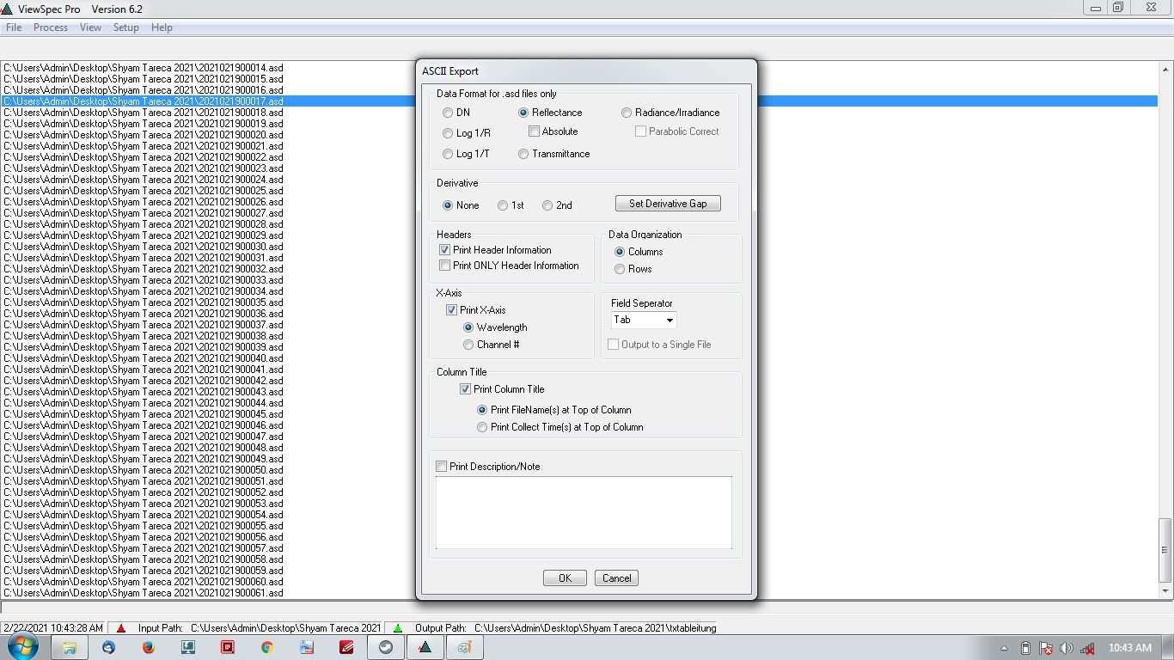
To export Reflectance data, choose setting as above
To export first derivative of reflectance (useful e.g. for red-edge detection), choose [Derivative → 1st]

Slide 4
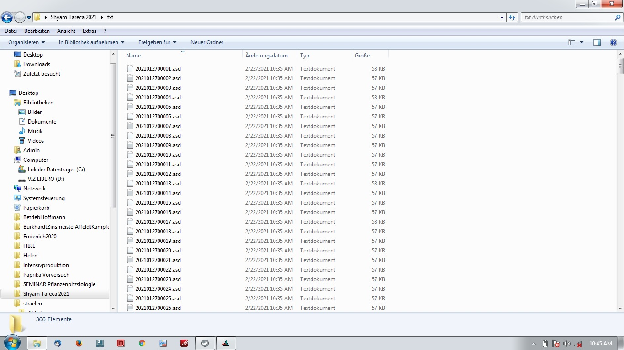
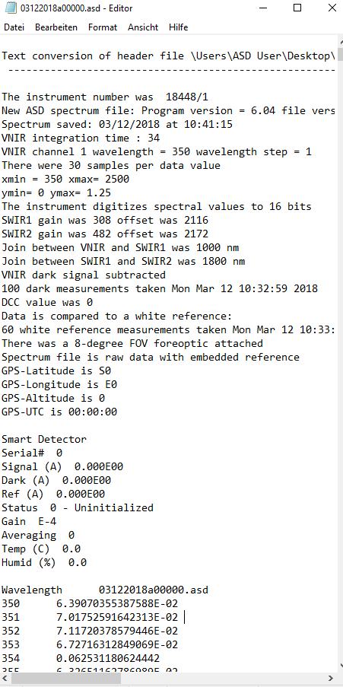
Check exported data:
Format: .txt
Size: approx. 57KB
Structure: See right screenshot
Copy data and transfer it to a different computer
Header
Reflectance

Slide 5
For further analysis, the individual .txt files have to be knitted to one large spreadsheet and annotated (e.g. plant number and treatment have to be added manually according to lists written while measuring).
We can use an R-Script to automate the knitting.
The script is available here:
https://github.com/JanEllenberger/fieldspeccode
The resulting .txt file can be imported in Excel (or any similar program) for annotation.
I will set up a second .pptx and .R for the next steps after annotation: Data visualization and analysis.

